Slide 1
Variational Autoencoders
Alon Oring, 28.05.18
Notes:
https://arxiv.org/pdf/1606.05908.pdf
https://arxiv.org/pdf/1502.04623.pdf
https://arxiv.org/pdf/1602.05473.pdf
https://arxiv.org/pdf/1511.06349.pdf
http://blog.fastforwardlabs.com/2016/08/12/introducing-variational-autoencoders-in-prose-and.html
http://blog.fastforwardlabs.com/2016/08/22/under-the-hood-of-the-variational-autoencoder-in.html
https://ermongroup.github.io/cs228-notes/extras/vae/
http://kvfrans.com/variational-autoencoders-explained/
https://stats.stackexchange.com/questions/267924/explanation-of-the-free-bits-technique-for-variational-autoencoders
http://szhao.me/https://www.cs.princeton.edu/courses/archive/spring17/cos598E/Ghassen.pdf
2017/06/10/a-tutorial-on-mmd-variational-autoencoders.html
https://www.jeremyjordan.me/variational-autoencoders/
שקף 40 – לבדוק האם בכלל נחוץ
לעשות מעבר ברור יותר אחרי הparameterization trick
לבדוק את המתמטיקה ולהוסיף שלבים שיהיה ברור יותר
מה בדיוק intractable – P(x) או P(x|z) או אחרים?
חוסר אחידות – לפעמים posterior ולפעמים likelihood
לתת דגש על איך אני עושה את ה-Image Generation אחרי הכל
אינטואיציה לcross entropy – אין וצריך
את האנימציה של L – להבין היטב. מה ה-KL מייצג שם?

Slide 2
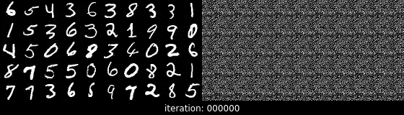
Recap - Autoencoders
Traditional AE are models designed to output a reconstruction of their input by deconstructing input data into hidden representations and reconstructing them into the original input
The appeal of this setup is that the model learns its own definition of a salient representation based only on data – no labels or heuristics

Slide 3
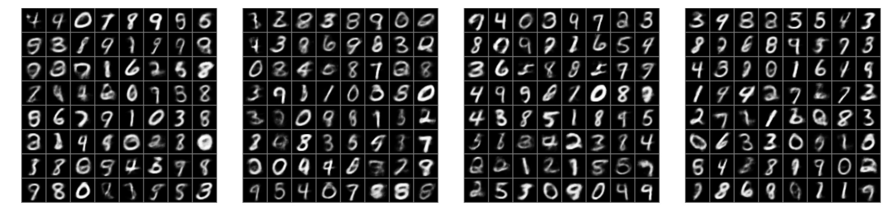
Variational Autoencoders
A probabilistic twist on autoencoders that enables:
Novel image synthesis from random samples
Transition from image to image or from mode to mode
Aggregation of similar images to close locations in the latent space

Slide 4
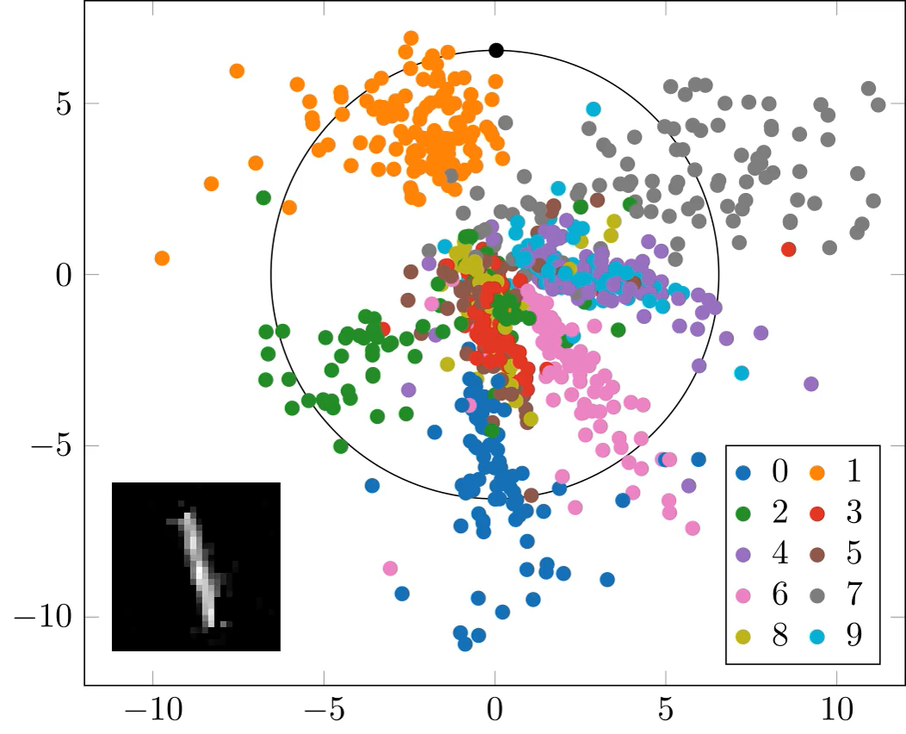
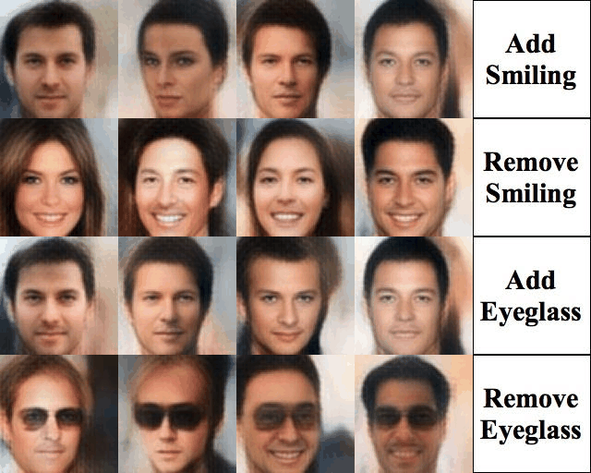
Motivation
Variational Autoencoders are a deep learning technique for learning useful latent representations
Regular Autoencoder on MNIST dataset
Variational Autoencoder on CelebA dataset
Notes:
https://gertjanvandenburg.com/blog/autoencoder/
https://github.com/houxianxu/DFC-VAE

Slide 5
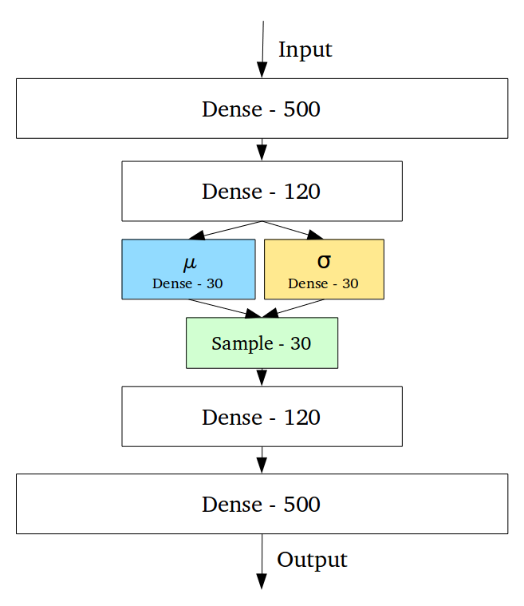
Architecture
Very similar to the regular autoencoder
The probabilistic nature of the VAE is enabled using a sampling layer

Slide 6
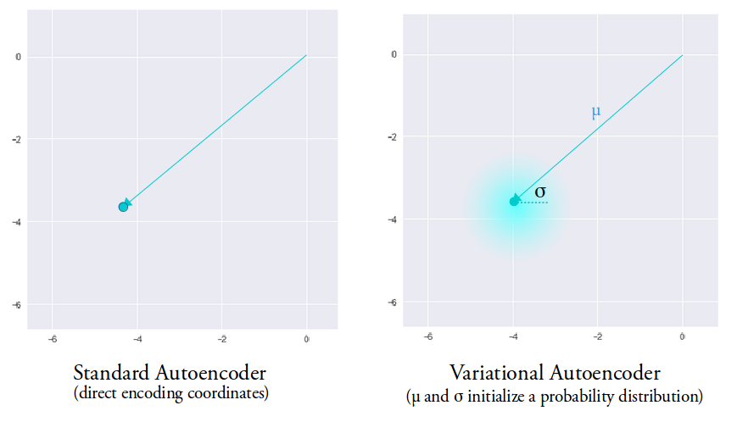
VAE – Probabilistic Intuition

Slide 7
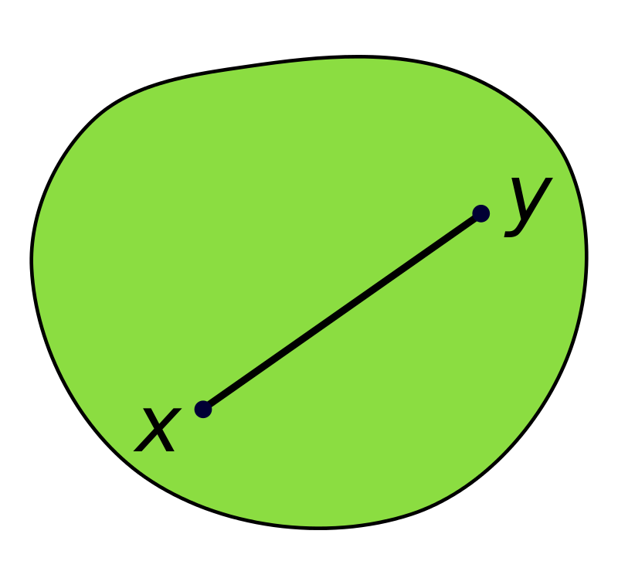
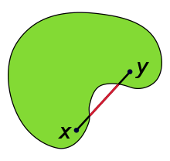
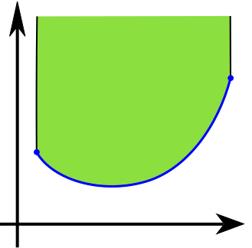
Note on Convexity
Convex Set
Non-Convex Set
Convex Function

Slide 8
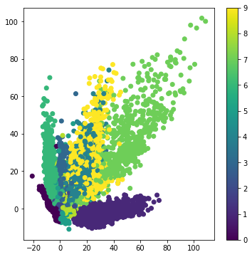
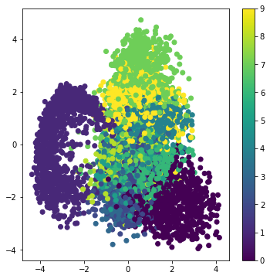
Latent Space Representation
Autoencoder
Variational Autoencoder

Slide 9
Information Theory Recap

Slide 10
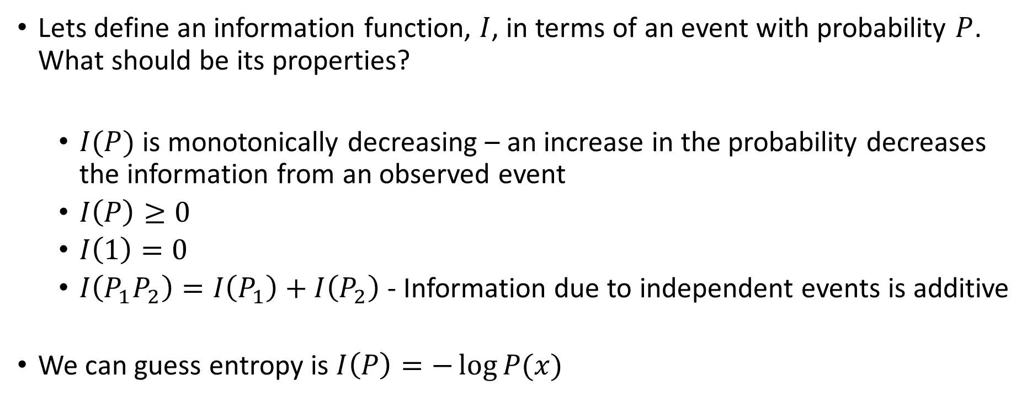
Information – Definition and Intuition
Lets define an information function, $I$, in terms of an event with probability $P$. What should be its properties?
$I(P)$ is monotonically decreasing – an increase in the probability decreases the information from an observed event
$I\left(P\right)≥0$
$I\left(1\right)=0$
$I\left(P_{1}P_{2}\right)=I\left(P_{1}\right)+I\left(P_{2}\right)$ - Information due to independent events is additive
We can guess entropy is $I\left(P\right)=−\log{P(x)}$

Slide 11
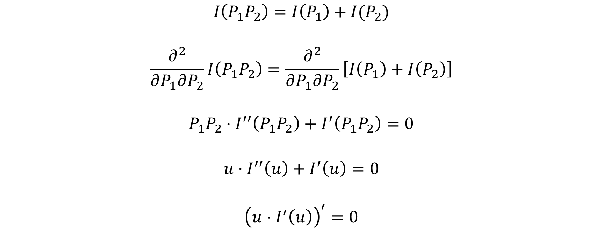
Information - Derivation
$$I\left(P_{1}P_{2}\right)=I\left(P_{1}\right)+I(P_{2})$$
$$\frac{∂^{2}}{∂P_{1}∂P_{2}}I\left(P_{1}P_{2}\right)=\frac{∂^{2}}{∂P_{1}∂P_{2}}\left[I\left(P_{1}\right)+I\left(P_{2}\right)\right]$$
$$P_{1}P_{2}⋅I^{′′}\left(P_{1}P_{2}\right)+I^{′}\left(P_{1}P_{2}\right)=0$$
$$u⋅I^{′′}\left(u\right)+I^{′}\left(u\right)=0$$
$${\left(u⋅I^{′}\left(u\right)\right)}^{′}=0$$

Slide 12
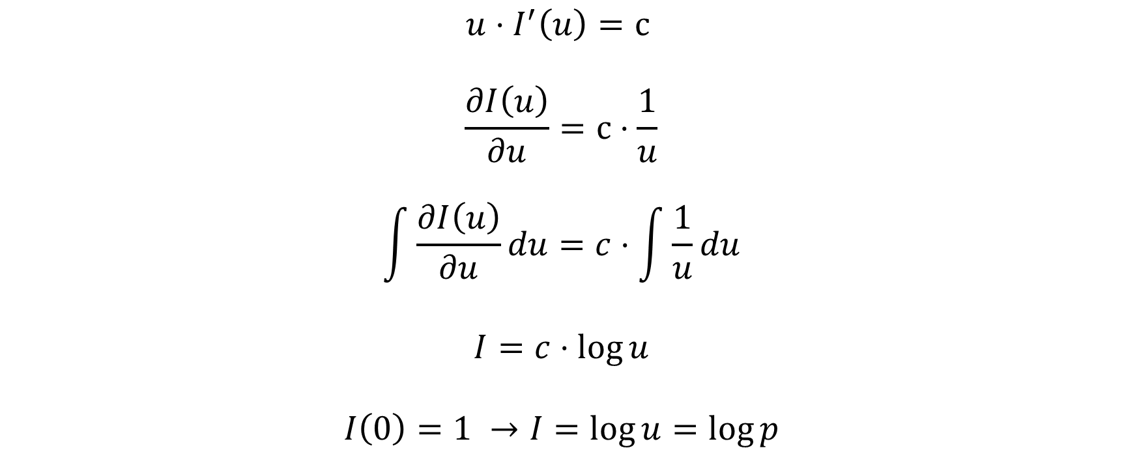
Information – Derivation – Cont.
$$u⋅I^{′}\left(u\right)=c$$
$$\frac{∂I\left(u\right)}{∂u}=c⋅\frac{1}{u}$$
$$\int{\frac{∂I\left(u\right)}{∂u}du}=c⋅\int{\frac{1}{u}}du$$
$$I=c⋅\log{u}$$
$$I\left(0\right)=1 →I=\log{u}=\log{p}$$

Slide 13
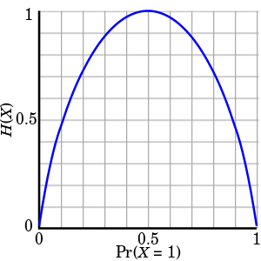
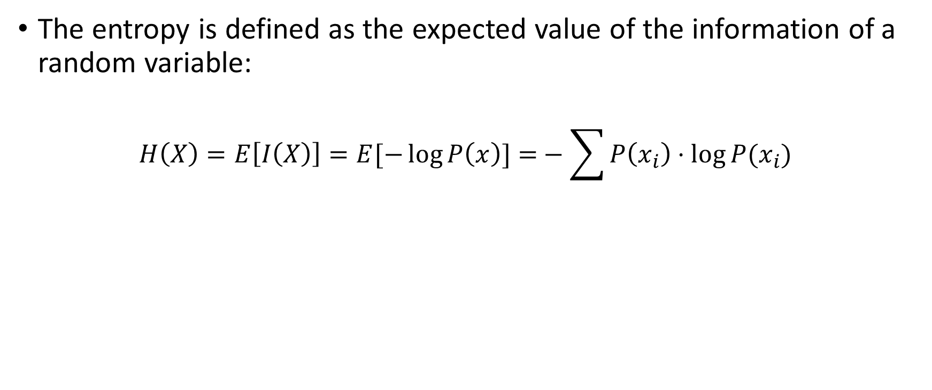
Entropy – Definition
The entropy is defined as the expected value of the information of a random variable:
$$H\left(X\right)=E\left[I\left(X\right)\right]=E[−\log{P\left(x\right)]=}−\sum{P\left(x_{i}\right)⋅\log{P(x_{i})} }$$

Slide 14
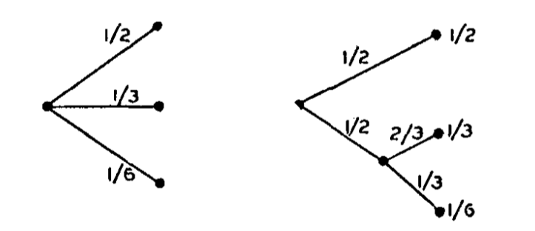
Entropy - Intuition
Lets define a measure of the amount of information a discrete random variable produces, or the cost of encoding a specific distribution
Continuous
If all probabilities are equal, the entropy (uncertainty) is maximal
If a choice is broken into two successive choices, the original measure should be the weighted sum of the individual values of the measure
Notes:
http://circuit.ucsd.edu/~yhk/ece287a-win08/shannon1948.pdf – Appendix II contains the derivation of Entropy and the proof that the current form is the only possible function that satisfies the requirements above.

Slide 15
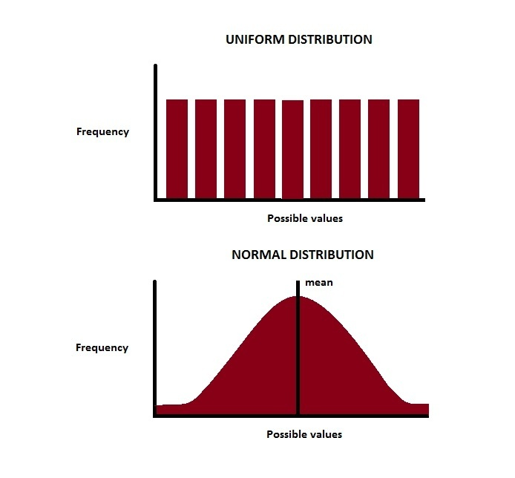
Entropy - Intuition
The maximum entropy is the one that corresponds to the least amount of knowledge defined by the probability density function
When can we expect maximum entropy for the following cases:
Among probability distributions over a finite range of values?
Among probability distributions over a infinite range of values?

Slide 16
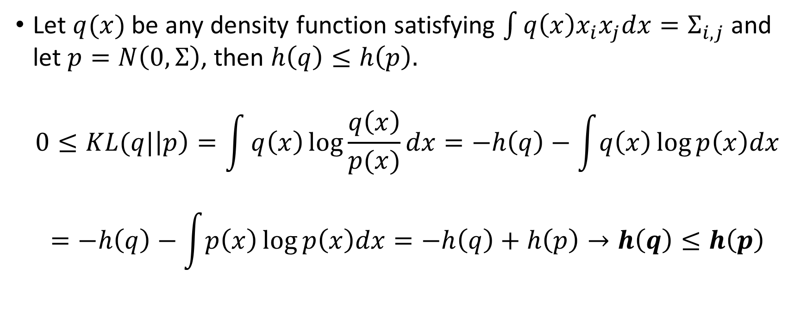
Proof of Gaussians having maximum Entropy
Let $q(x)$ be any density function satisfying $\int{q\left(x\right)x_{i}x_{j}dx=Σ_{i,j}}$ and let $p=N\left(0,Σ\right)$, then $h\left(q\right)≤h\left(p\right).$
$$0≤KL(q|\left|p\right)=\int{q\left(x\right)\log{\frac{q\left(x\right)}{p(x)}dx=−h\left(q\right)−\int{q\left(x\right)\log{p\left(x\right)dx}}}}$$
$$=−h\left(q\right)−\int{p\left(x\right)\log{p\left(x\right)dx}}=−h\left(q\right)+h\left(p\right)→h\left(q\right)≤h\left(p\right)$$
Notes:
The third equality holds since the both p and q have the same 2nd order moments. This can be shown by taking into account that the log of the Gaussian p is a quadratic function of x with no linear terms (zero mean) and by evaluating the integral of (q-p)*log(p) and deriving that it is identically zero.

Slide 17
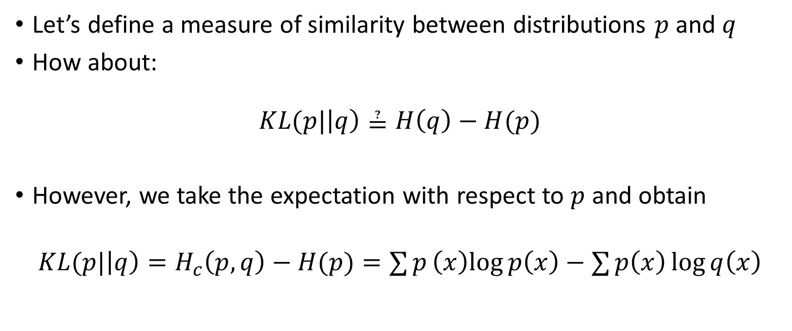
Kullback–Leibler Divergence
Let’s define a measure of similarity between distributions $p$ and $q$
How about:
$$KL(p|\left|q\right)≟H\left(q\right)−H(p)$$
However, we take the expectation with respect to $p$ and obtain
$$KL(p|\left|q\right)=H_{c}\left(p,q\right)−H(p)=∑{p\left(x\right)log{p\left(x\right)}−∑{p\left(x\right)\log{q\left(x\right)}}}$$
Notes:
The cross-entropy can be interpreted as the number of bits per message needed (on average) to encode events drawn from true distribution p, if using an optimal code for distribution q.
KL-Divergence measures the average number of EXTRA bits per message whereas the cross entropy measures the average number of TOTAL bits per message.

Slide 18
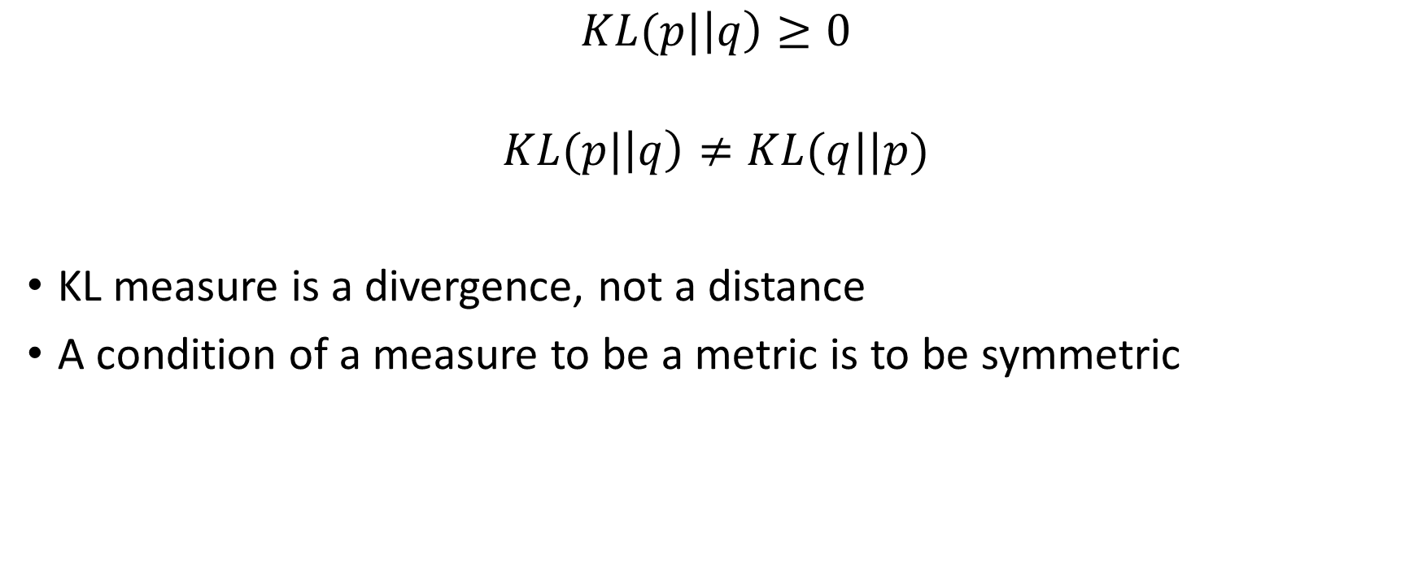
Kullback–Leibler Divergence Properties
$$KL(p|\left|q\right)≥0$$
$$KL(p|\left|q\right)≠KL(q||p)$$
KL measure is a divergence, not a distance
A condition of a measure to be a metric is to be symmetric

Slide 19
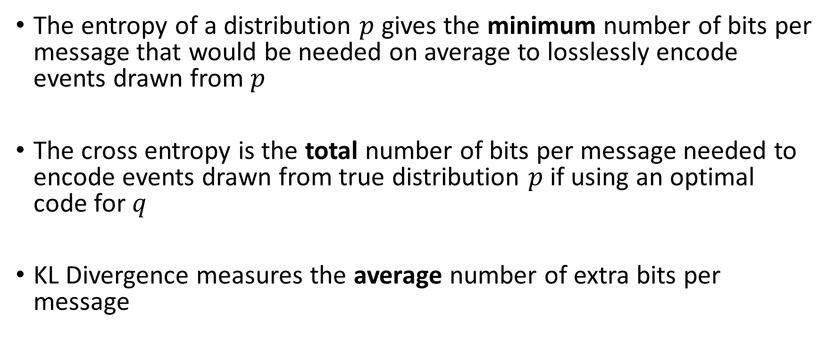
Information Theory - Summary
The entropy of a distribution $p$ gives the minimum number of bits per message that would be needed on average to losslessly encode events drawn from $p$
The cross entropy is the total number of bits per message needed to encode events drawn from true distribution $p$ if using an optimal code for $q$
KL Divergence measures the average number of extra bits per message

Slide 20
Information Theory Perspective
Notes:
https://arxiv.org/pdf/1606.05908.pdf
http://kvfrans.com/variational-autoencoders-explained/
http://szhao.me/2017/06/10/a-tutorial-on-mmd-variational-autoencoders.html
http://blog.fastforwardlabs.com/2016/08/12/introducing-variational-autoencoders-in-prose-and.html
http://blog.fastforwardlabs.com/2016/08/22/under-the-hood-of-the-variational-autoencoder-in.html
https://stats.stackexchange.com/questions/267924/explanation-of-the-free-bits-technique-for-variational-autoencoders
https://www.cs.princeton.edu/courses/archive/spring17/cos598E/Ghassen.pdf
https://arxiv.org/pdf/1502.04623.pdf
https://arxiv.org/pdf/1602.05473.pdf
https://arxiv.org/pdf/1511.06349.pdf
https://www.jeremyjordan.me/variational-autoencoders/
https://ermongroup.github.io/cs228-notes/extras/vae/

Slide 21
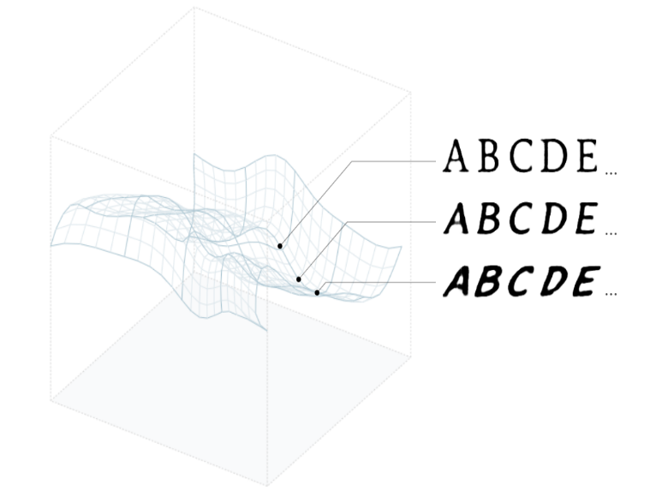
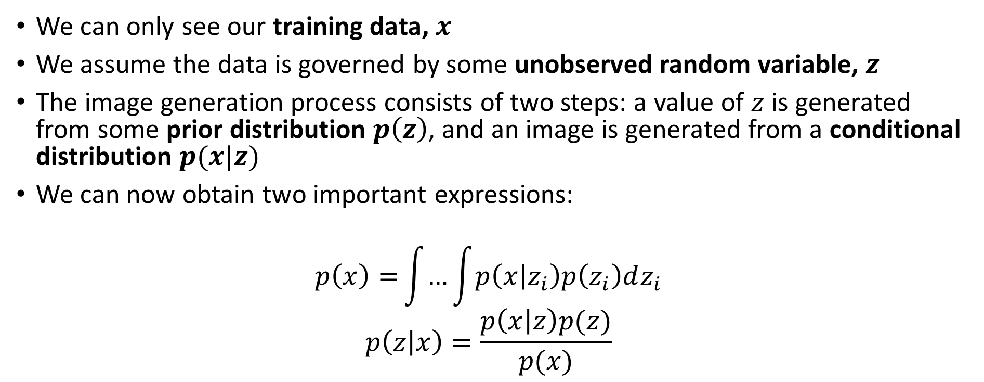
Latent Variable Models – General Case
We can only see our training data, $x$
We assume the data is governed by some unobserved random variable, $z$
The image generation process consists of two steps: a value of $z$ is generated from some prior distribution $p\left(z\right)$, and an image is generated from a conditional distribution $p(x|z)$
We can now obtain two important expressions:
$$p\left(x\right){=}\int{…}\int{p\left(x | z_{i}\right)p\left(z_{i}\right)dz_{i}}$$
$$p\left(z | x\right)=\frac{p\left(x | z\right)p(z)}{p(x)}$$
Notes:
https://distill.pub/2017/aia

Slide 22
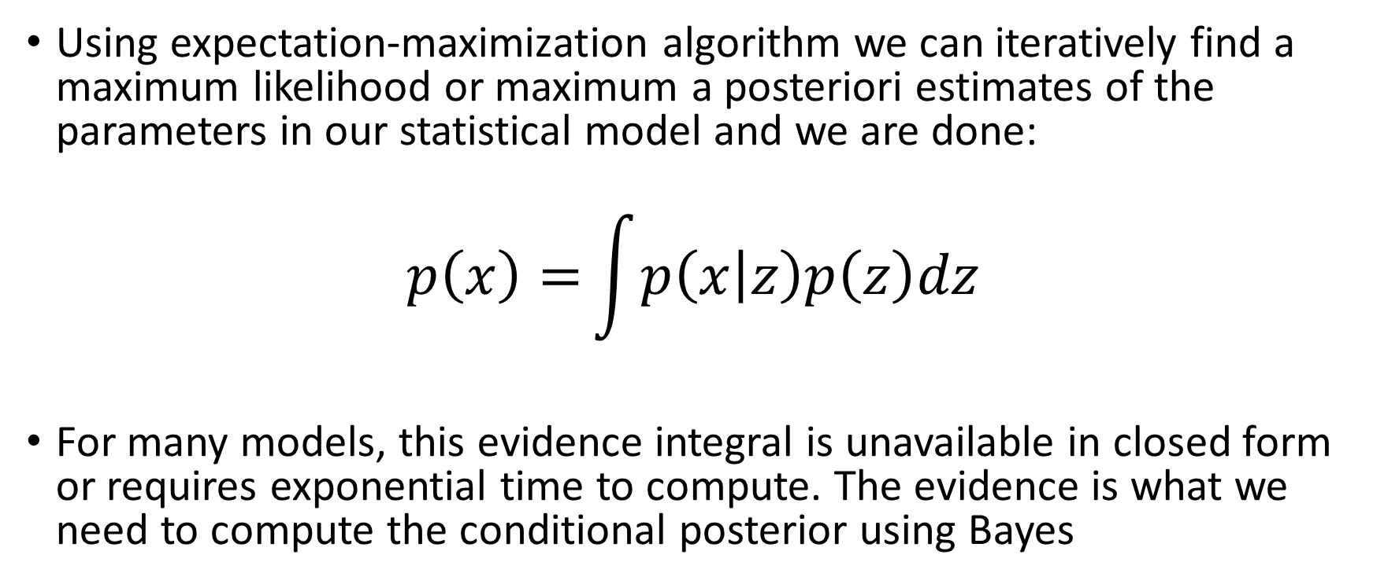
Learning Statistical Models
Using expectation-maximization algorithm we can iteratively find a maximum likelihood or maximum a posteriori estimates of the parameters in our statistical model and we are done:
$$p\left(x\right){=}\int{p\left(x | z\right)p\left(z\right)dz}$$
For many models, this evidence integral is unavailable in closed form or requires exponential time to compute. The evidence is what we need to compute the conditional posterior using Bayes

Slide 23
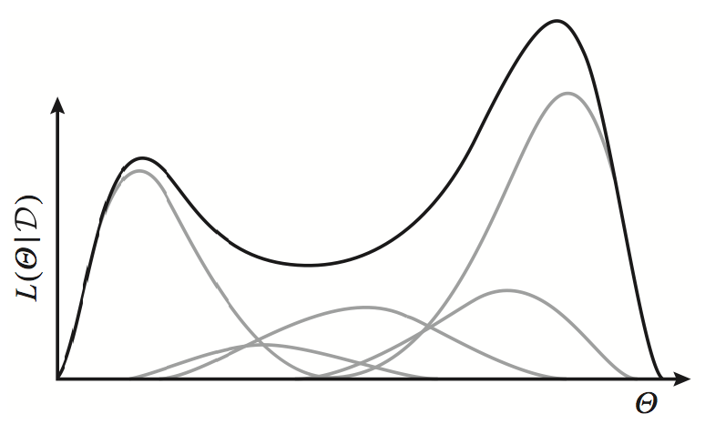
Intractability - Intuition
Notes:
The exponential family distributions have concave log-likelihoods. However, a weighted mixture of such distributions is no longer concave

Slide 24
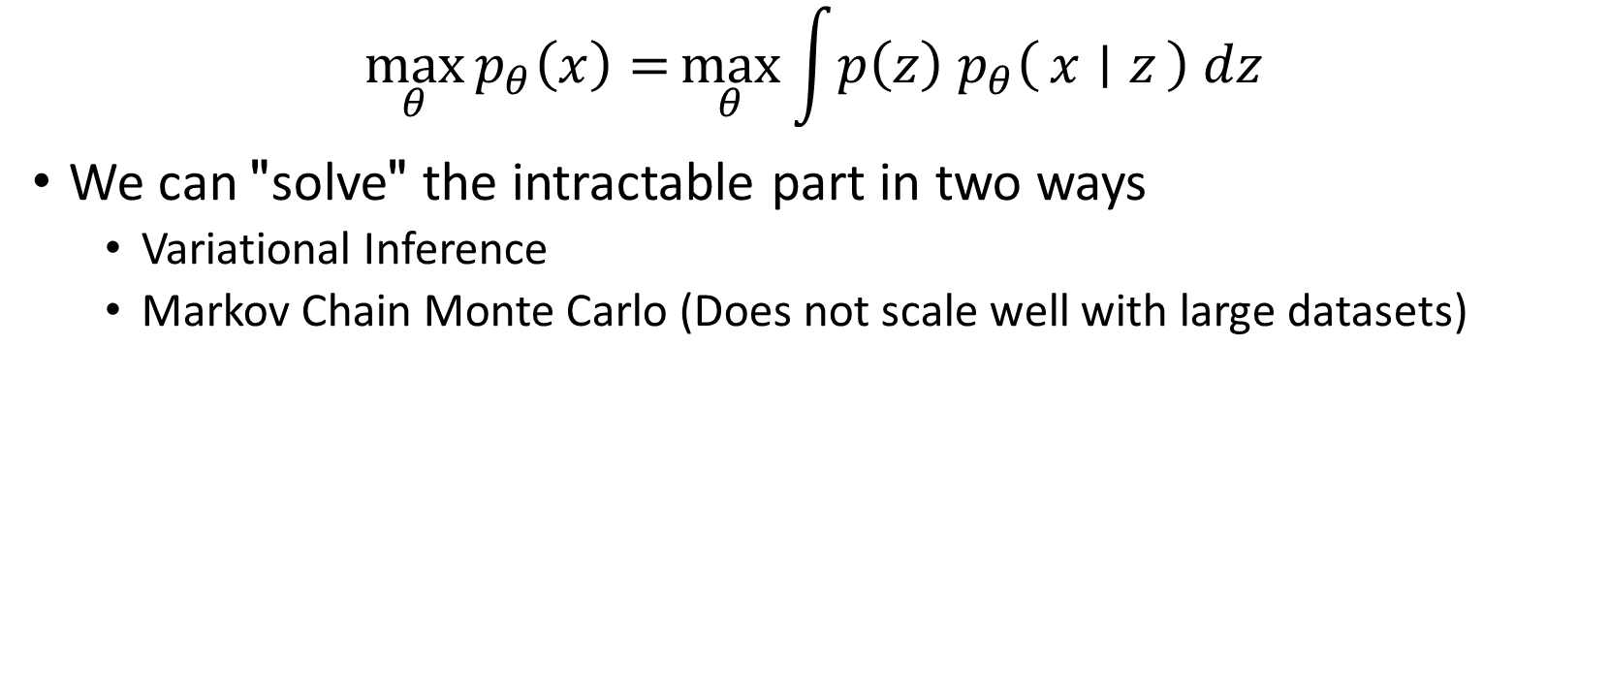
Intractability
$$\max_{θ}{p_{θ}\left(x\right)=}\max_{θ}{\int{p\left(z\right){ p}_{θ}\left(x ∣ z\right) dz}}$$
We can "solve" the intractable part in two ways
Variational Inference
Markov Chain Monte Carlo (Does not scale well with large datasets)

Slide 25
Variational Inference
Notes:
https://arxiv.org/pdf/1606.05908.pdf
http://kvfrans.com/variational-autoencoders-explained/
http://szhao.me/2017/06/10/a-tutorial-on-mmd-variational-autoencoders.html
http://blog.fastforwardlabs.com/2016/08/12/introducing-variational-autoencoders-in-prose-and.html
http://blog.fastforwardlabs.com/2016/08/22/under-the-hood-of-the-variational-autoencoder-in.html
https://stats.stackexchange.com/questions/267924/explanation-of-the-free-bits-technique-for-variational-autoencoders
https://www.cs.princeton.edu/courses/archive/spring17/cos598E/Ghassen.pdf
https://arxiv.org/pdf/1502.04623.pdf
https://arxiv.org/pdf/1602.05473.pdf
https://arxiv.org/pdf/1511.06349.pdf
https://www.jeremyjordan.me/variational-autoencoders/
https://ermongroup.github.io/cs228-notes/extras/vae/

Slide 26
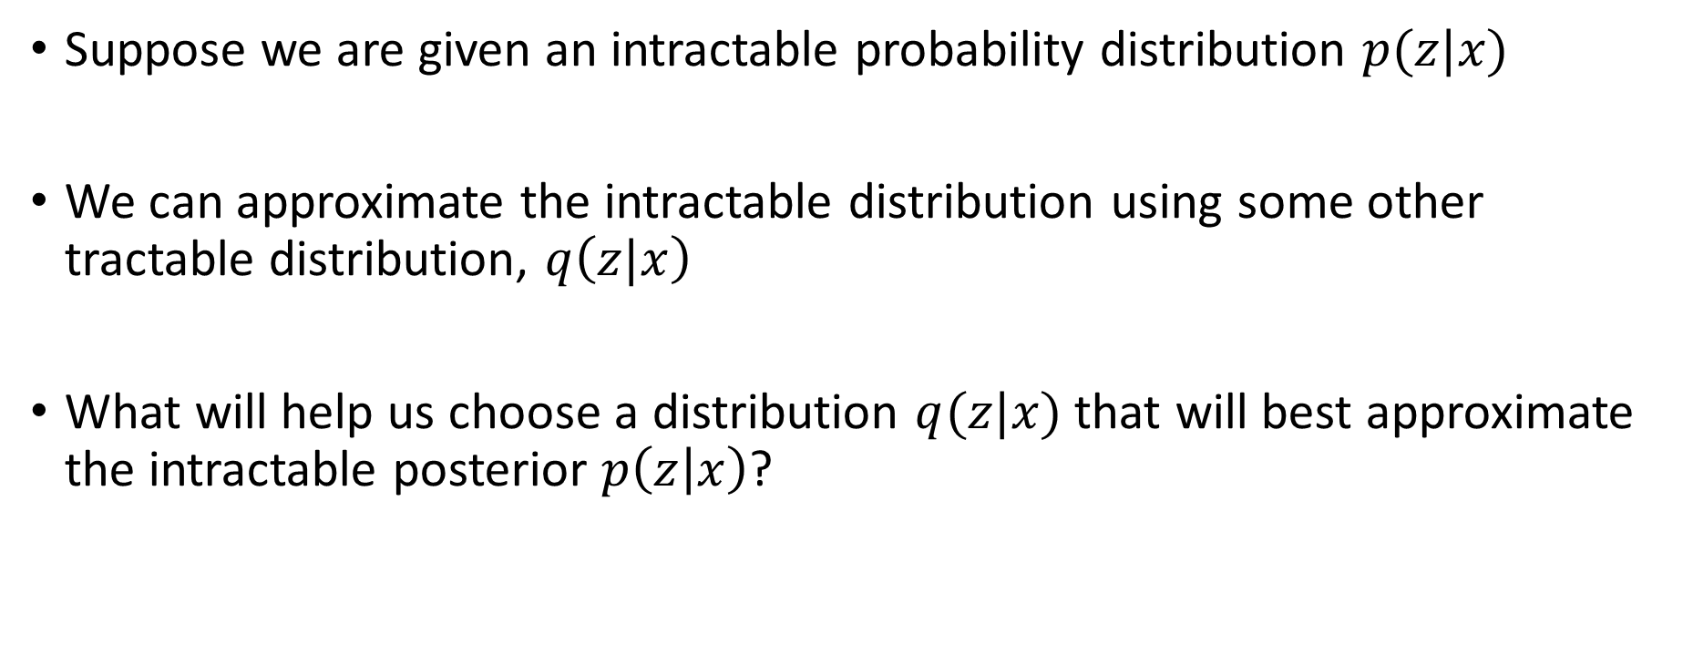
Variational Inference
Suppose we are given an intractable probability distribution $p(z|x)$
We can approximate the intractable distribution using some other tractable distribution, $q\left(z|x\right)$
What will help us choose a distribution $q(z|x)$ that will best approximate the intractable posterior $p\left(z | x\right)$?

Slide 27
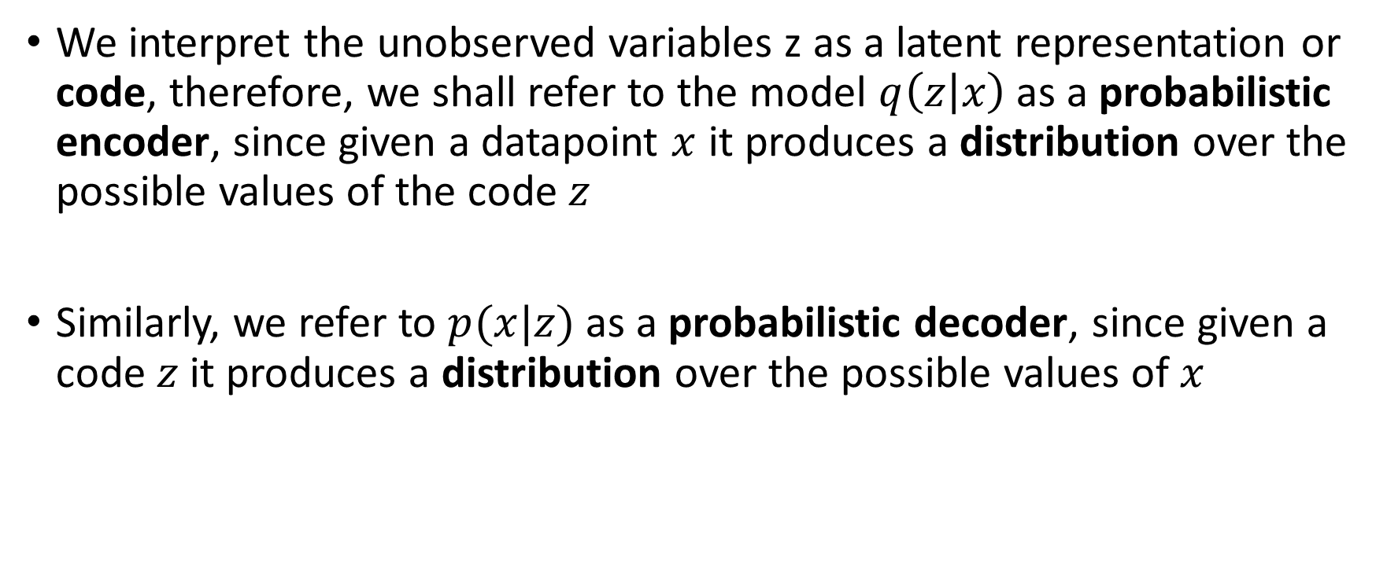
Information Theory Revisited
We interpret the unobserved variables z as a latent representation or code, therefore, we shall refer to the model $q\left(z | x\right)$ as a probabilistic encoder, since given a datapoint $x$ it produces a distribution over the possible values of the code $z$
Similarly, we refer to $p(x|z)$ as a probabilistic decoder, since given a code $z$ it produces a distribution over the possible values of $x$

Slide 28
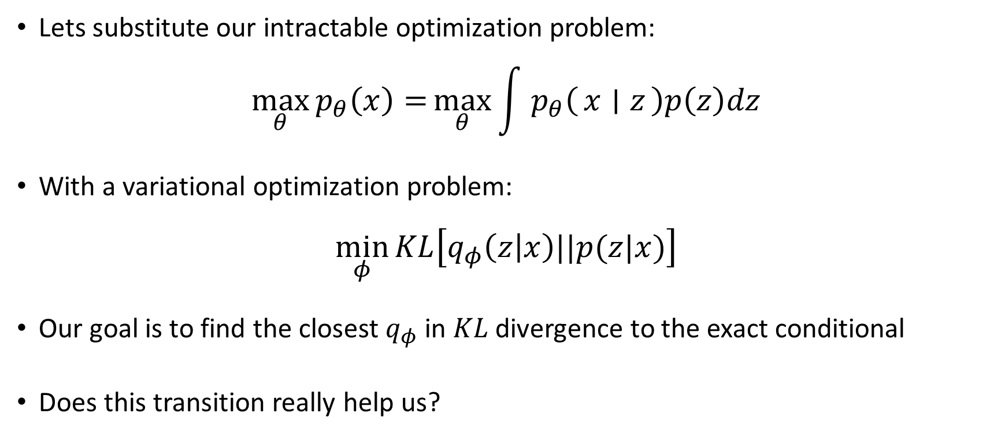
Back to the optimization problem
Lets substitute our intractable optimization problem:
$$\max_{θ}{p_{θ}\left(x\right)=}\max_{θ}{\int{{ p}_{θ}\left(x ∣ z\right)p\left(z\right)dz}}$$
With a variational optimization problem:
$$\min_{φ}{KL\left[q_{φ}\left(z | x\right)||p(z|x)\right]}$$
Our goal is to find the closest $q_{φ}$ in $KL$ divergence to the exact conditional
Does this transition really help us?

Slide 29
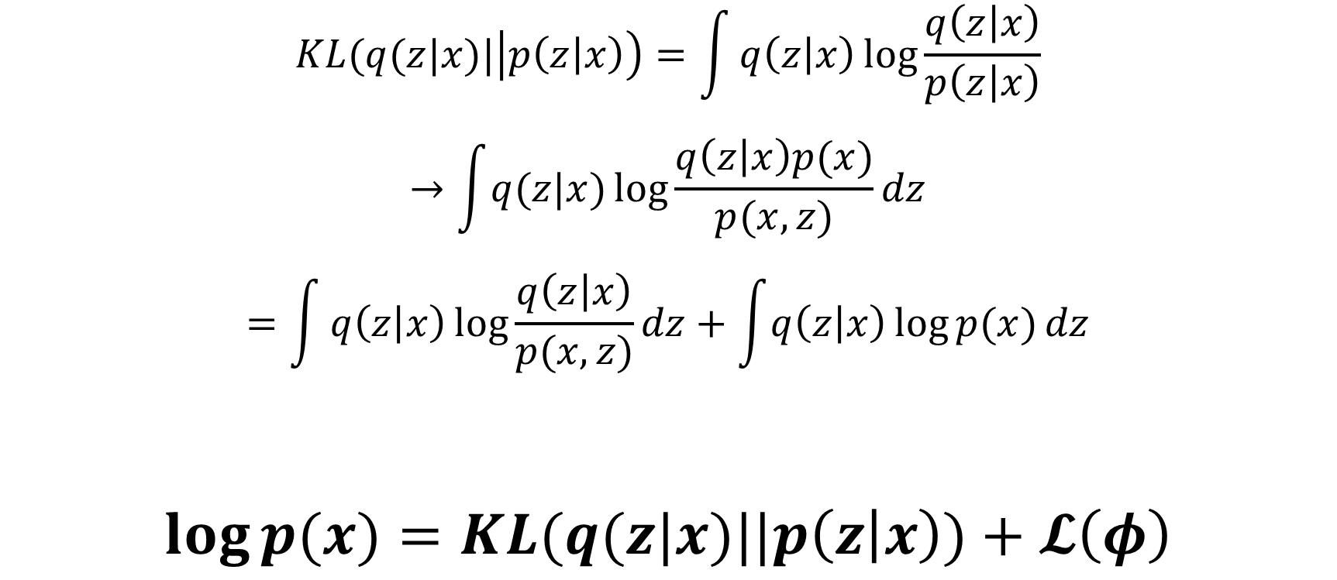
Let the derivations begin
$$KL(q(z|x)|\left|p\left(z | x\right)\right)=\int{q\left(z | x\right)\log{\frac{q\left(z | x\right)}{p\left(z | x\right)}}}$$
$$→\int{q(z|x)}\log{\frac{q\left(z | x\right)p(x)}{p(x,z)}dz}$$
$$=\int{q\left(z | x\right)\log{\frac{q\left(z | x\right)}{p(x,z)}}dz}+\int{q\left(z | x\right)\log{p(x)}dz}$$
$$\log{p(x)}=KL(q(z|x)||p\left(z | x\right))+𝓛\left(φ\right)$$
Notes:
Even this does not help us at all. This expression requires us to compute the evidence and the posterior which was the reason we started this journey in the first place.
However, if we could by some miracle maximize the Evidence Lower Bound (Spoiler Alert), we could make progress.

Slide 30
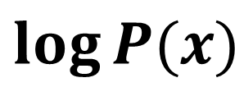
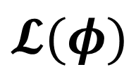
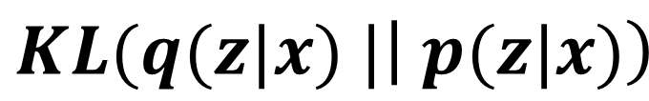
“Minimizing” KL Divergence
$$KL(q(z|x) |\left| p(z|x)\right)$$
$$\log{P(x)}$$
$$𝓛(φ)$$
$$\log{p(x)}=KL(q(z|x)||p\left(z | x\right))+𝓛\left(φ\right)$$

Slide 31
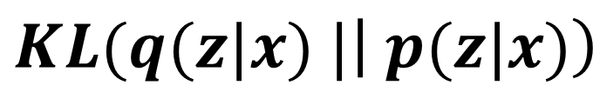
“Minimizing” KL Divergence
$$KL(q(z|x) |\left| p(z|x)\right)$$
$$\log{P(x)}$$
$$𝓛(φ)$$
$$\log{p(x)}=KL(q(z|x)||p\left(z | x\right))+𝓛\left(φ\right)$$

Slide 32
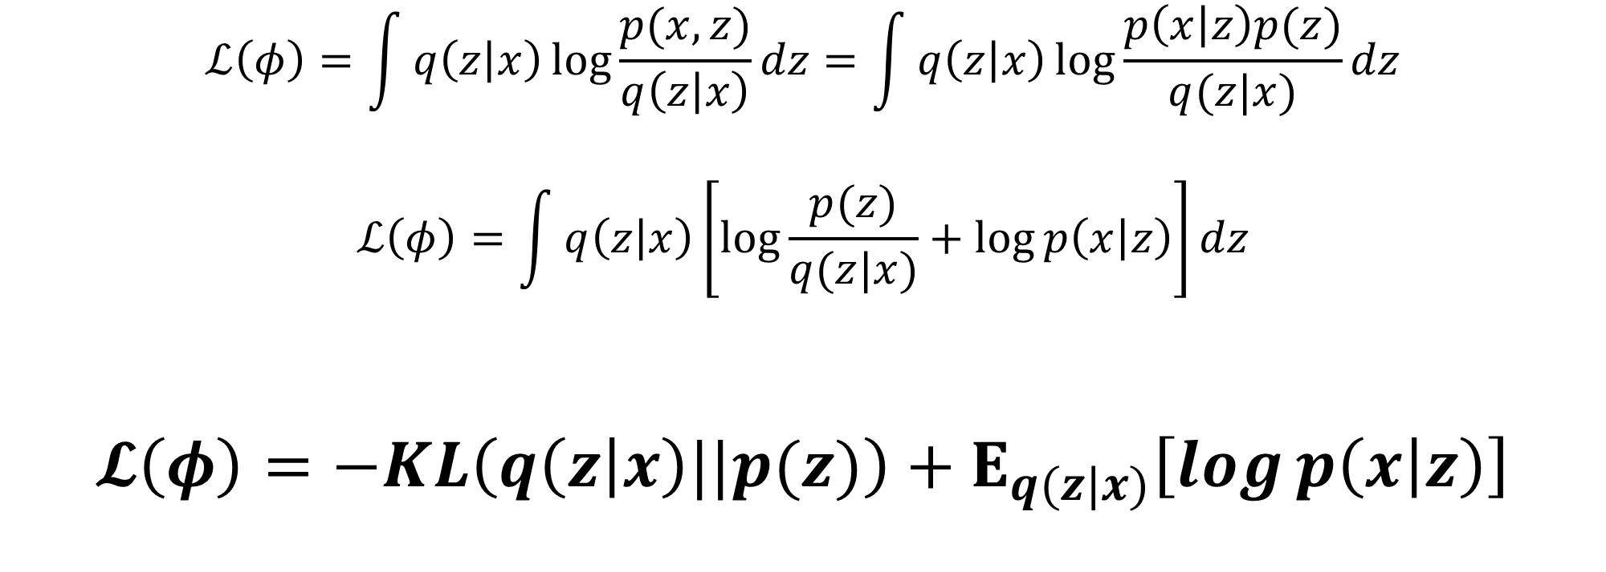
Evidence Lower BOund (ELBO)
$$ℒ\left(φ\right)=\int{q\left(z | x\right)\log{\frac{p(x,z)}{q\left(z | x\right)}}dz}=\int{q\left(z | x\right)\log{\frac{p\left(x | z\right)p(z)}{q(z|x)}}}dz$$
$$ℒ\left(φ\right)=\int{q\left(z | x\right)\left[\log{\frac{p(z)}{q(z|x)}}+\log{p\left(x | z\right)}\right]}dz$$
$$𝓛\left(φ\right)=−KL\left(q\left(z | x\right)||p(z)\right)+E_{q(z|x)}\left[\log{p\left(x | z\right)}\right]$$

Slide 33
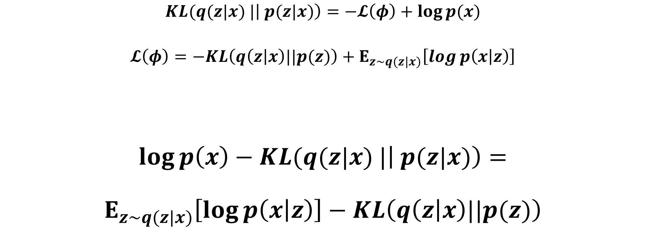
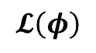
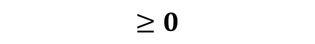
Putting it all together
$$KL(q(z|x) |\left| p(z|x)\right)=−𝓛\left(φ\right)+\log{p(x)}$$
$$𝓛\left(φ\right)=−KL\left(q\left(z | x\right)||p(z)\right)+E_{z\sim q(z|x)}\left[\log{p\left(x | z\right)}\right]$$
$$\log{p\left(x\right)−KL(q(z|x) |\left| p(z|x)\right)}=$$
$$E_{z\sim q(z|x)}\left[\log{p\left(x | z\right)}\right]−KL\left(q\left(z | x\right)||p(z)\right)$$
Assume P is Gaussian. What does this mean?
What about Bernoulli?
Does not depend on z
We push the approximate posterior to the prior
$$≥0$$
$$𝓛\left(φ\right)$$
Notes:
The top has the quantity we want to maximize: P and an error we hope will be small (since we produce a high capacity Q) The right hand size will be optimized via SGD
Log(p(x)) is independent of z and the original intractable KL divergence is \ge 0, thus we can instead argue that we want to maximize L.
We can also look at log(p(x)) as the total number of bits required to construct x under our model using an ideal encoding.
We use some bits to construct z, and the left KL divergence tells us how much bits we used, because we assumed that any z from P(z) has no information about x.
Thus, the total number of bits is the sum of those two steps (reconstruction sampling from p(z)) minus a penalty we pay for q being sub-optimal.

Slide 34
What we have so far
We want to learn a latent variable model
The likelihood and posterior are intractable and we can’t use EM
We approximate the posterior using a tractable function and use KL divergence to pick the best possible approximation
Because we cannot compute the KL, we optimize an alternative objective that is equivalent to the KL up to an added constant
The ELBO has similar properties to a regularized autoencoder

Slide 35
Neural Network Perspective
Notes:
https://arxiv.org/pdf/1606.05908.pdf
http://kvfrans.com/variational-autoencoders-explained/
http://szhao.me/2017/06/10/a-tutorial-on-mmd-variational-autoencoders.html
http://blog.fastforwardlabs.com/2016/08/12/introducing-variational-autoencoders-in-prose-and.html
http://blog.fastforwardlabs.com/2016/08/22/under-the-hood-of-the-variational-autoencoder-in.html
https://stats.stackexchange.com/questions/267924/explanation-of-the-free-bits-technique-for-variational-autoencoders
https://www.cs.princeton.edu/courses/archive/spring17/cos598E/Ghassen.pdf
https://arxiv.org/pdf/1502.04623.pdf
https://arxiv.org/pdf/1602.05473.pdf
https://arxiv.org/pdf/1511.06349.pdf
https://www.jeremyjordan.me/variational-autoencoders/
https://ermongroup.github.io/cs228-notes/extras/vae/

Slide 36
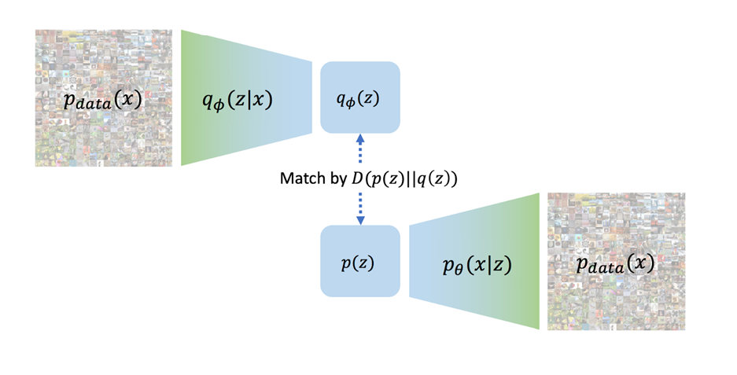
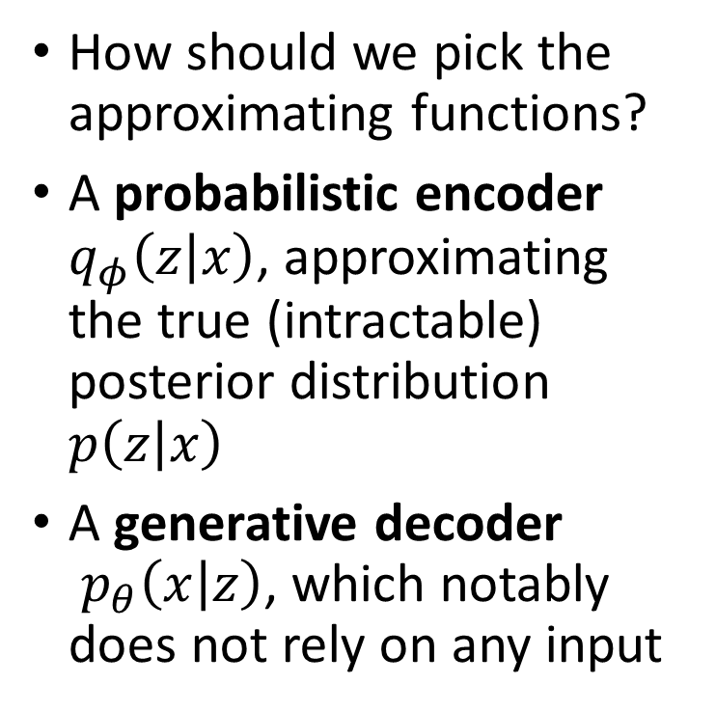
In practice
How should we pick the approximating functions?
A probabilistic encoder $q_{φ}\left(z | x\right)$, approximating the true (intractable) posterior distribution $p\left(z | x\right)$
A generative decoder $p_{θ}\left(x | z\right)$, which notably does not rely on any input

Slide 37
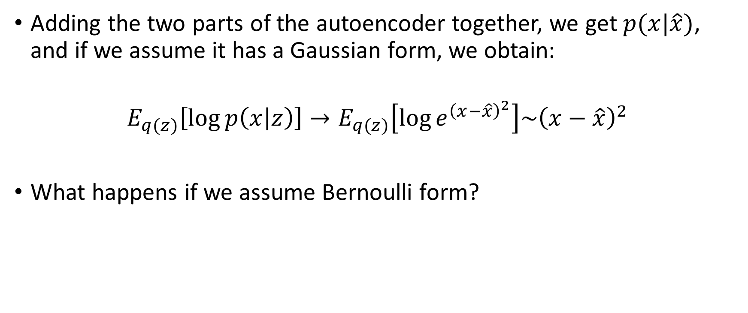
Lower Bound: Reconstruction Error
Adding the two parts of the autoencoder together, we get $p(x|\hat{x})$, and if we assume it has a Gaussian form, we obtain:
$$E_{q(z)}\left[\log{p\left(x | z\right)}\right]→E_{q(z)}\left[\log{e^{{\left(x−\hat{x}\right)}^{2}}}\right]\sim {\left(x−\hat{x}\right)}^{2}$$
What happens if we assume Bernoulli form?

Slide 38
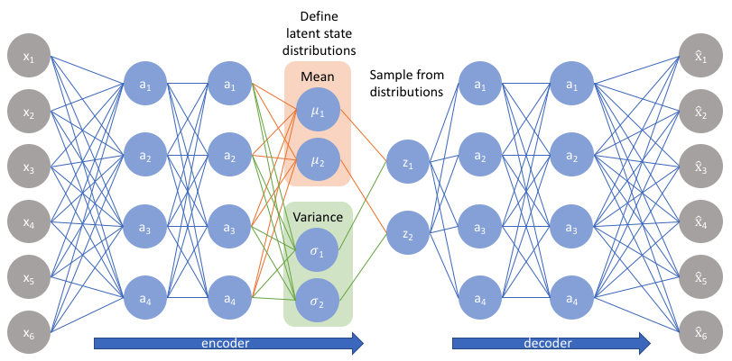
The Variational Autoencoder

Slide 39
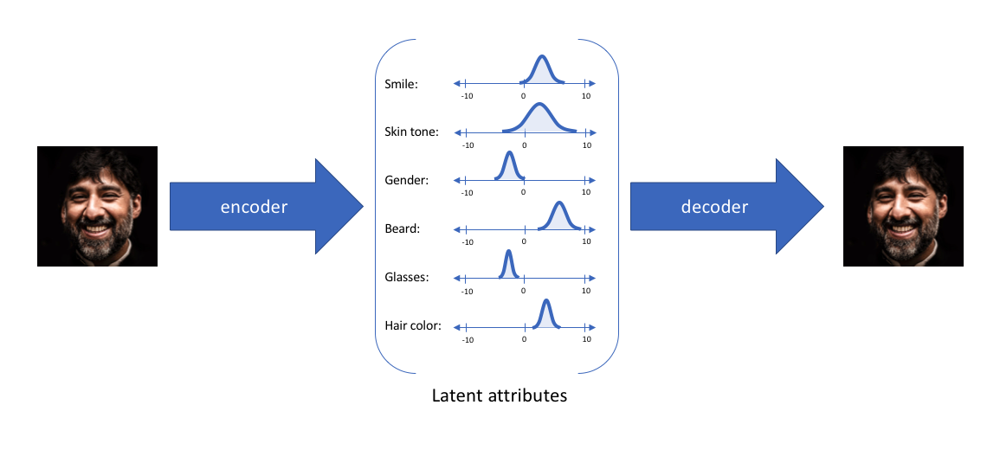
Features as Probability Distributions
Image taken from jeremyjordan.me/variational-autoencoders/
Notes:
In the interval [0,1], for example, we can encode an infinite amount of information using real numbers. We constructed the VAE

Slide 40
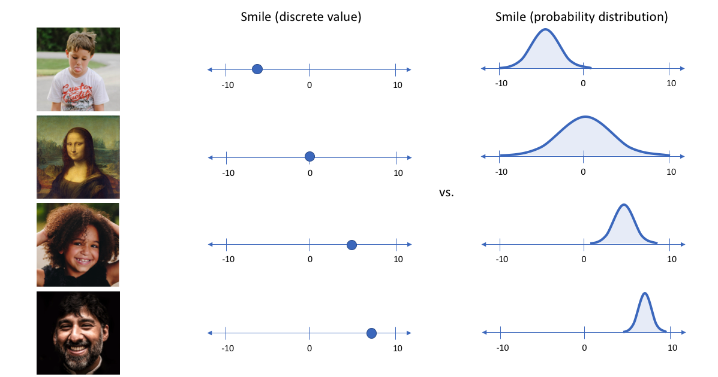
Features as Probability Distributions
Notes:
We represent each latent attribute for a give input as a probability distribution. When decoding from the latent state, we randomly sample from each latent state to generate a vector as a input for our decoder model. By forcing our decoder model to reconstruct the same image from a distribution of latent states, we enforce a continuous, smooth latent space representation.
For any sampling of the latent distributions, we are expecting our decoder model to be able to reconstruct the input. Thus, close values will create similar reconstructions.

Slide 41
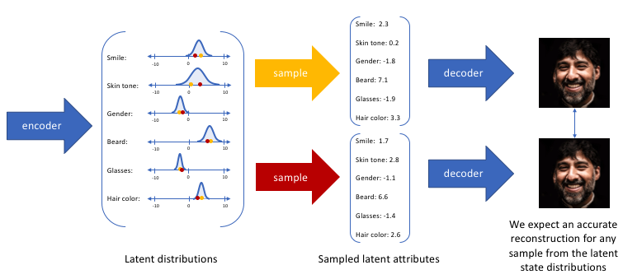
Features as Probability Distributions
Image taken from jeremyjordan.me/variational-autoencoders/
Notes:
https://www.jeremyjordan.me/variational-autoencoders/

Slide 42
The Variational Autoencoder

Slide 43
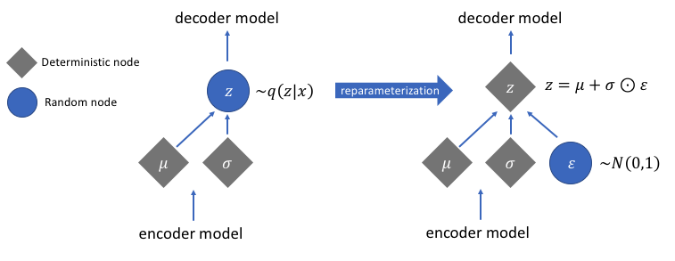
Sample Layer

Slide 44
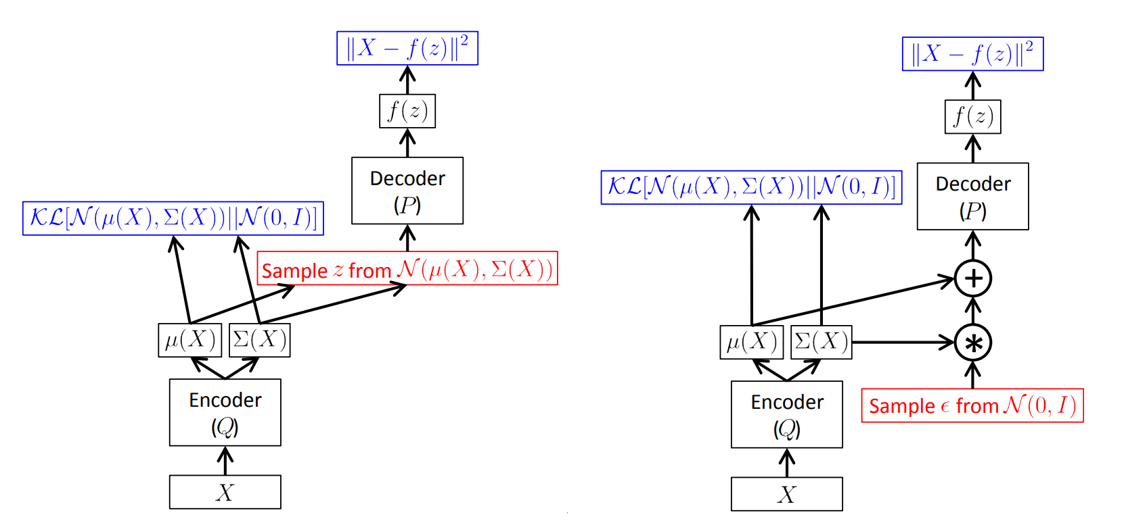
Back-Propagation through Random Operations
Notes:
Traditional NN implement a deterministic transformation of some input variables x. When developing generative models, we extend NN to implement stochastic transformations.

Slide 45
Notes:
Traditional NN implement a deterministic transformation of some input variables x. When developing generative models, we extend NN to implement stochastic transformations.

Slide 46
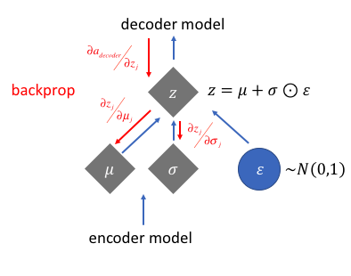
Back-Propagation through Random Operations

Slide 47
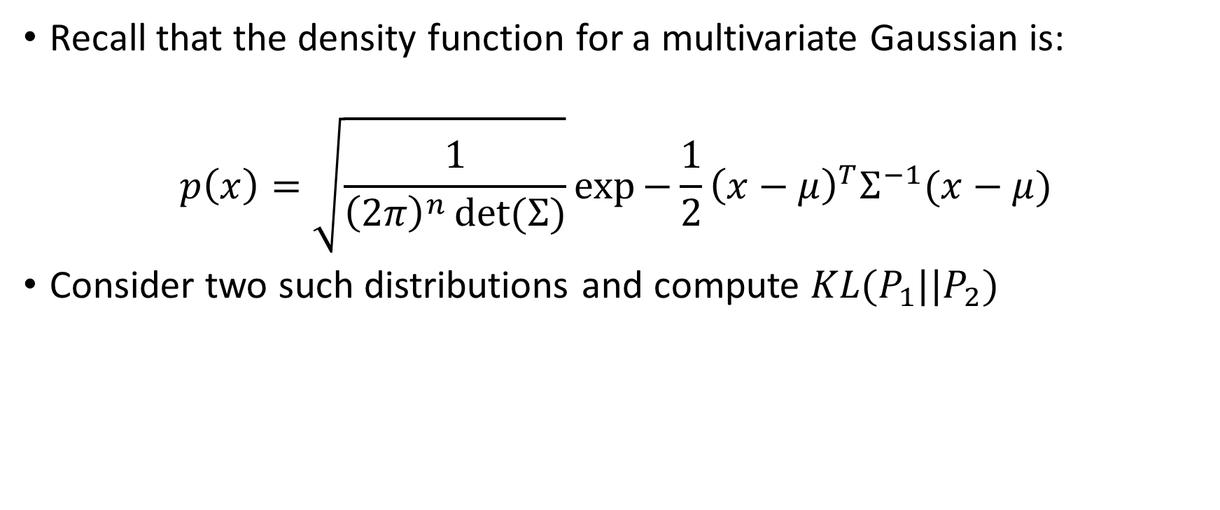
KL Divergence for Gaussian Distributions
Recall that the density function for a multivariate Gaussian is:
$$p\left(x\right)=\sqrt{\frac{1}{{\left(2π\right)}^{n}\det{(Σ)}}}\exp{−\frac{1}{2}{\left(x−μ\right)}^{T}Σ^{−1}(x−μ)}$$
Consider two such distributions and compute $KL(P_{1}||P_{2})$

Slide 48

KL Divergence for Gaussian Distributions

Slide 49
KL Divergence in code
$$KL[N(μ,Σ)||N\left(0,1\right)]=−\frac{1}{2}\left[n+log(det\left(Σ\right))−μ^{T}μ−tr\left(Σ\right)\right]$$
vae = Model(x, x_recon)
recon_loss = metrics.binary_crossentropy(x, x_recon)
kl_loss = -0.5 * K.sum(1 + z_log_var – K.square(z_mean) – K.exp(z_log_var), axis=-1)
vae_loss = K.mean(kl_loss(
vae.add_loss(vae_loss)
vae.compile(optimizer='rmsprop', loss=None)

Slide 50
Back to VAE motivation
VAE are a deep learning technique for learning useful latent representations
Image Generation
Latent Space Interpolation
Latent Space Arithmetic
Is the new learned latent space useful?

Slide 51

Latent Space Visualizations
KL Divergence
Reconstruction
Reconstruction + KL Divergence
Notes:
Penalizing reconstruction loss encourages the distribution to describe the input and deviate from the prior
Without regularization, our network can learn narrow distributions. With a small enough variance, the distribution is effectively only representing a single value, detached from different values of the same attribute
Penalizing the KL divergence ensures sufficient variance to yield a smooth latent space

Slide 52


Generating Numbers (MNIST)
Generating Images from VAE
“Generating” Images from Traditional AE

Slide 53

Generating Faces (CelebA)

Slide 54






Latent Space Interpolation
If the latent space representation is useful, maybe we could take two different images, represent them as points in latent space, and create images from the line connecting the two points?

Slide 55

Latent Space Arithmetic
Instead of interpolation, could we extract the latent vector responsible for a specific attribute?

Slide 56


Latent Space Arithmetic
Notes:
In this example we see images generated by some generating process. We pass each image through the encoder and get the latent representation for it. While in the latent space we perform our arithmetic and decode it back to the image space. This is how we can detect relevant “attribute” vectors in the latent space.

Slide 57

Latent Space Arithmetic
Notes:
Each row is generated faces from latent vector z by adding or subtracting an attribute specific vector

Slide 58

Music VAE

Slide 59

Summary
Probabilistic spin to traditional autoencoders
Defines an intractable distribution and optimizes a variational lower bound
Allows data generation and a useful latent representation
Samples blurrier and lower quality images compared to state-of-the-art techniques

Slide 60
Bibliography
https://arxiv.org/pdf/1312.6114.pdf
https://arxiv.org/pdf/1606.05908.pdf
https://arxiv.org/pdf/1502.04623.pdf
http://blog.fastforwardlabs.com/2016/08/12/introducing-variational-autoencoders-in-prose-and.html
http://blog.fastforwardlabs.com/2016/08/22/under-the-hood-of-the-variational-autoencoder-in.html
https://ermongroup.github.io/cs228-notes/extras/vae/
http://kvfrans.com/variational-autoencoders-explained/
https://stats.stackexchange.com/questions/267924/explanation-of-the-free-bits-technique-for-variational-autoencoders
http://szhao.me/2017/06/10/a-tutorial-on-mmd-variational-autoencoders.html
https://www.cs.princeton.edu/courses/archive/spring17/cos598E/Ghassen.pdf
https://www.jeremyjordan.me/variational-autoencoders/
Notes:
https://arxiv.org/pdf/1606.05908.pdf
https://arxiv.org/pdf/1502.04623.pdf
https://arxiv.org/pdf/1602.05473.pdf
https://arxiv.org/pdf/1511.06349.pdf
http://blog.fastforwardlabs.com/2016/08/12/introducing-variational-autoencoders-in-prose-and.html
http://blog.fastforwardlabs.com/2016/08/22/under-the-hood-of-the-variational-autoencoder-in.html
https://ermongroup.github.io/cs228-notes/extras/vae/
http://kvfrans.com/variational-autoencoders-explained/
https://stats.stackexchange.com/questions/267924/explanation-of-the-free-bits-technique-for-variational-autoencoders
http://szhao.me/2017/06/10/a-tutorial-on-mmd-variational-autoencoders.html
https://www.cs.princeton.edu/courses/archive/spring17/cos598E/Ghassen.pdf
https://www.jeremyjordan.me/variational-autoencoders/

